Slide 1


LENDING CLUB CASE STUDY
Group Members:
1. Vikas Upadhyaya
2. Harish Kumar C

Slide 2
Case Study Objectives
Understand the 'Driving Variables' behind Loan Default Phenomena
Loan Lending Organization may choose to utilize this knowledge for its portfolio and risk assessment of new loan application
Identification of Defaulters in Loan Application

Slide 3

Data Cleaning
Analysis
Univariate
Bivariate
* Flow Diagram of EDA

Slide 4

Data Cleaning Steps
• Delete columns: Delete unnecessary columns.
• Remove outliers: Remove high and low values that would disproportionately affect the results of your analysis.
• Missing values: Treat missing values with appropriate approach.
• Duplicate data: Remove identical rows, remove rows where some columns are identical.
• Filter rows: Filter by segment, filter by date period to get only the rows relevant to the analysis.

Slide 5

Analysis
● The essence of the whole project is to analyze and understand how consumer attributes and loan attributes are influencing the tendency of defaulting.
● We performed data cleaning and preparation on the Loan dataset:
○ Imputed the NA values for all the variables
○ Created two new columns:
■ Profit and Loss column
■ Ratio of funded amount and annual income
● During univariate analysis we have created:
○ Histograms and Bar charts to check out the distribution of all the driver variables
○ Box plots to detect the Outliers
○ Performed the Multivariate analysis to understand how different variables interact with each other.

Slide 6
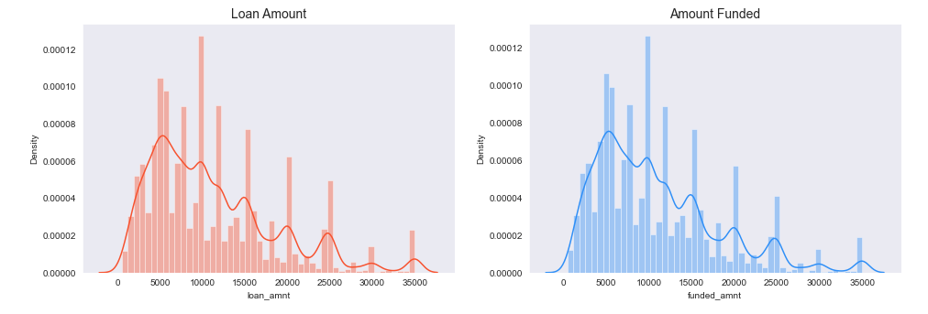
Observation: # Distribution of amounts for all two looks very much similar. # hence will work with only loan amount column for rest of our analysis.
Quantitative Variables
Univariant Analysis
Quantitative variables
Lets see distribution of two loan amount fields using distribution plot.
Quantitative Variables
Observation: Distribution of amounts for all two looks very much similar.
Hence will work with only loan amount column for rest of our analysis.

Slide 7
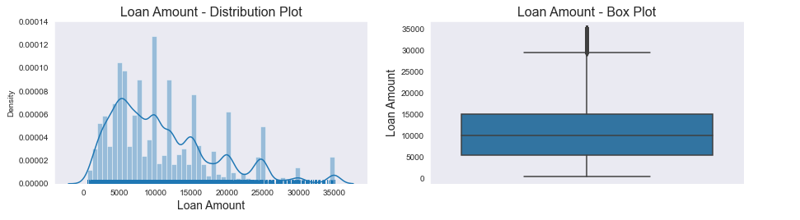
Loan amount - Quantitative variable
Observations: Below plots show that most of the Loan amounts are in range of 5000 - 15000

Slide 8
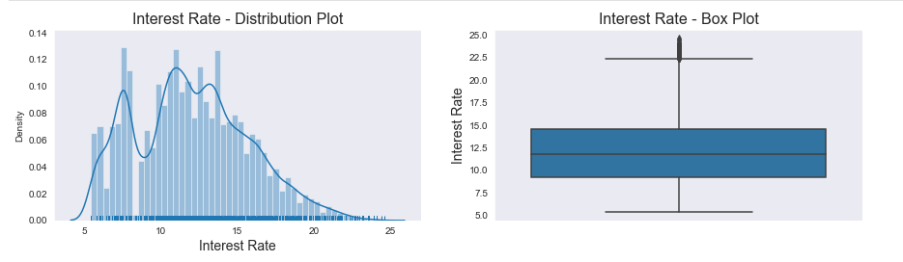
Interest Rate - Quantitative one
Observations : Below plots show that most of the Interest Rates on loans are in range of 10% - 15%

Slide 9
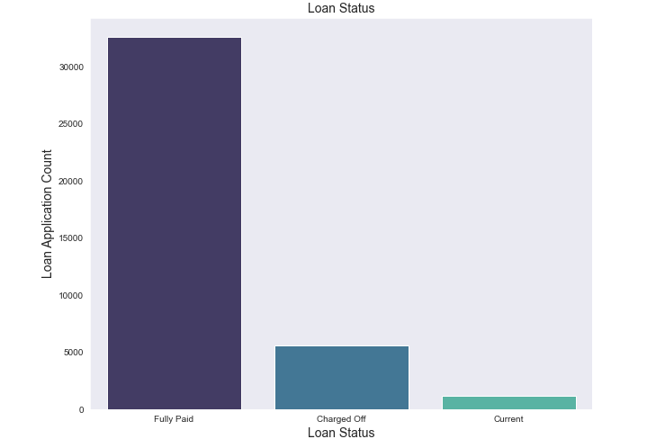
Univariant Analysis on Loan status
UnOrdered Categorical
Observations: Below plot shows that close to 14% loans were charged off out of total loan issued.

Slide 10
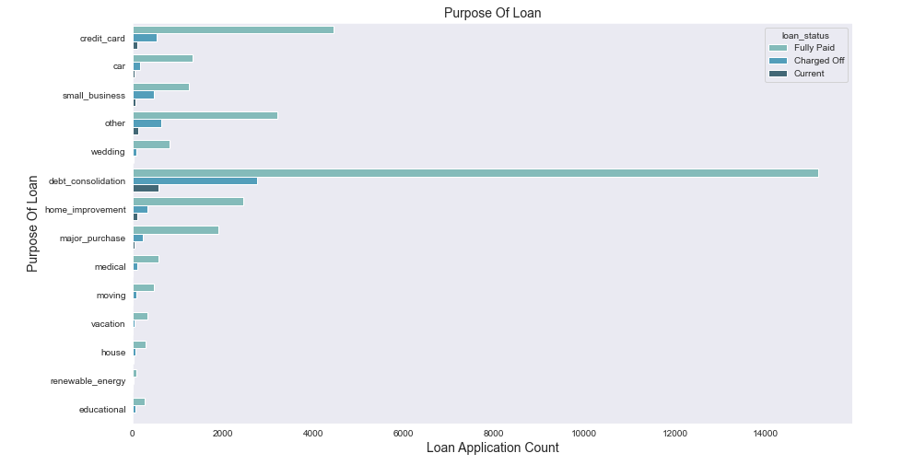
Univariant Analysis on Loan Purpose
UnOrdered Categorical
Observations: Below plot shows that most of the loans were taken for the
Number of charged off count also high too for these loans.
purpose of debt consolidation & paying credit card bill.

Slide 11
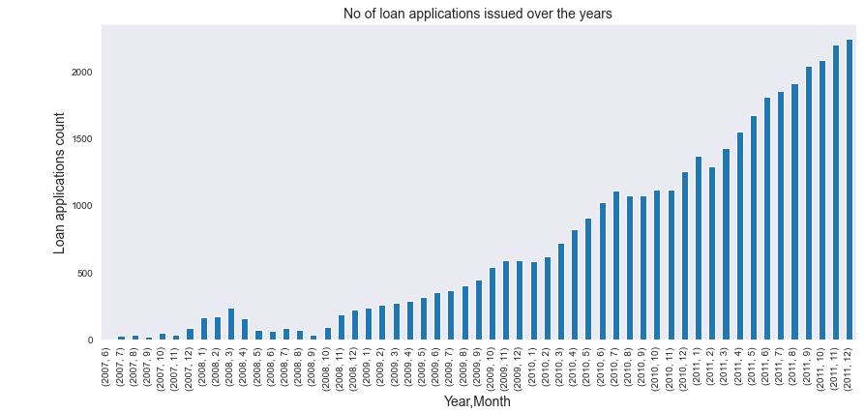
Univariant Analysis on Derive Columns
Ordered Categorical
Observation: Is that count of loan application is increasing every passing year.
so increase in number of loan applications are adding more to

Slide 12
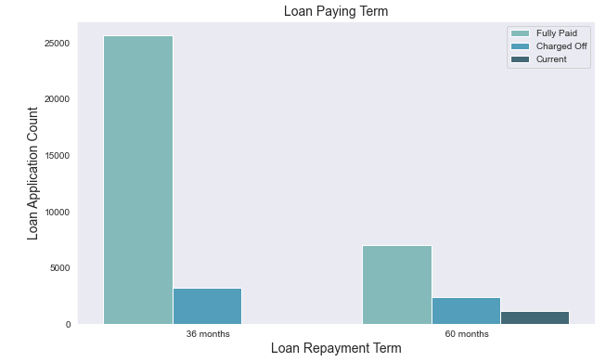
Univariant Analysis on loan paying term
Ordered Categorical
Observations: Below plot shows that those who had taken loan to repay in 60 months had more % of number of applicants getting
# charged off as compared to applicants who had taken loan for 36 months.

Slide 13
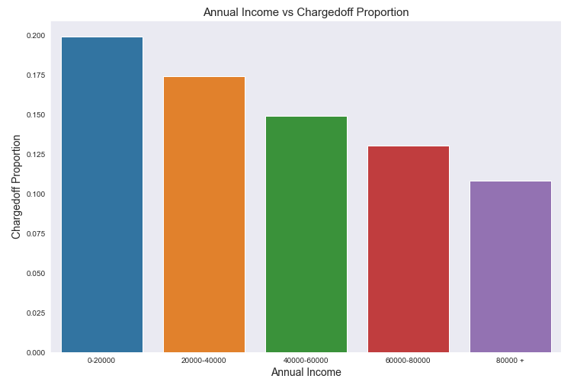
Bivariant Analysis
Bivariate Analysis on annual income against ChargedOff_Proportion
Observations:
# Income range 80000+ has less chances of charged off.
# Income range 0-20000 has high chances of charged off.
# Notice that with increase in annual income charged off proportion got decreased.

Slide 14
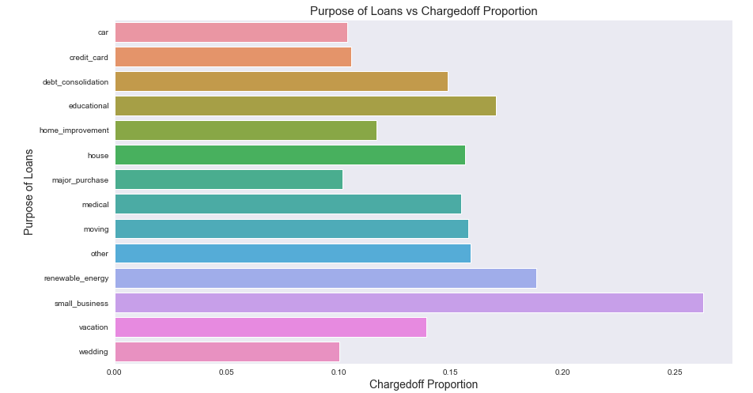
Bivariate Analysis on purpose of Loan against
Chargedoff_Proportion.
Observations:
1. small Business applicants have high chnaces of getting charged off.
2. renewable_energy where chanrged off proportion is better as compare to other categories.

Slide 15
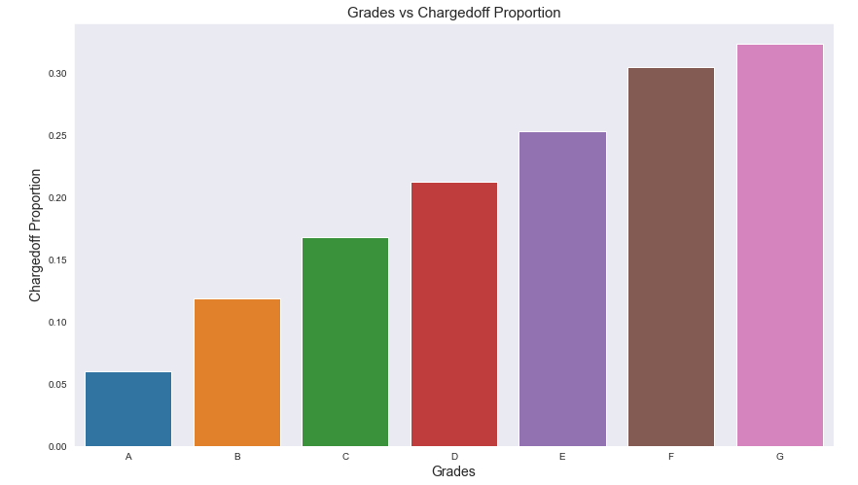
Bivariate Analysis on grade against Chargedoff_Proportion
Observations:
# Grade "A" has very less chances of charged off.
# Grade "F" and "G" have very high chances of charged off.
# Chances of charged off is increasing with grade moving from "A" towards "G"

Slide 16
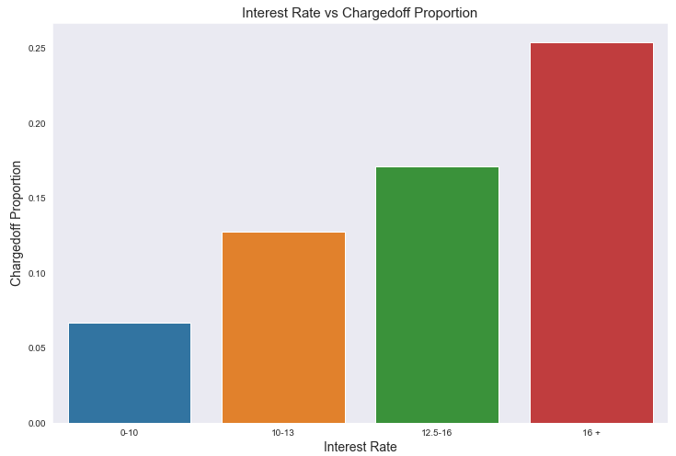
Bivariate Analysis on interest rate against Chargedoff_Proportion
Observations:
# interest rate less than 10% has very less chances of charged off. Intrest rates are starting from minimin 5 %.
# interest rate more than 16% has good chnaces of charged off as compared to other category intrest rates.
# Charged off proportion is increasing with higher intrest rates.

Slide 17
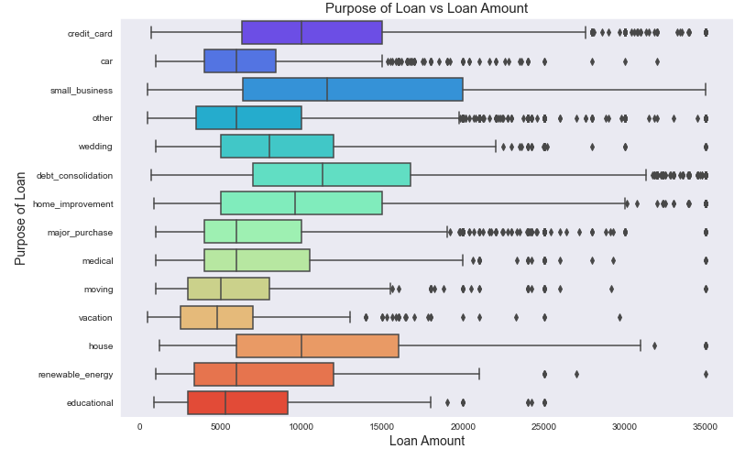
Bivariant Analysis using Boxplot Puprose of loan vs Loan amount
Observations:
# Median,95th percentile,75th percentile of loan amount is highest for loan taken for small business purpose among all purposes.

Slide 18
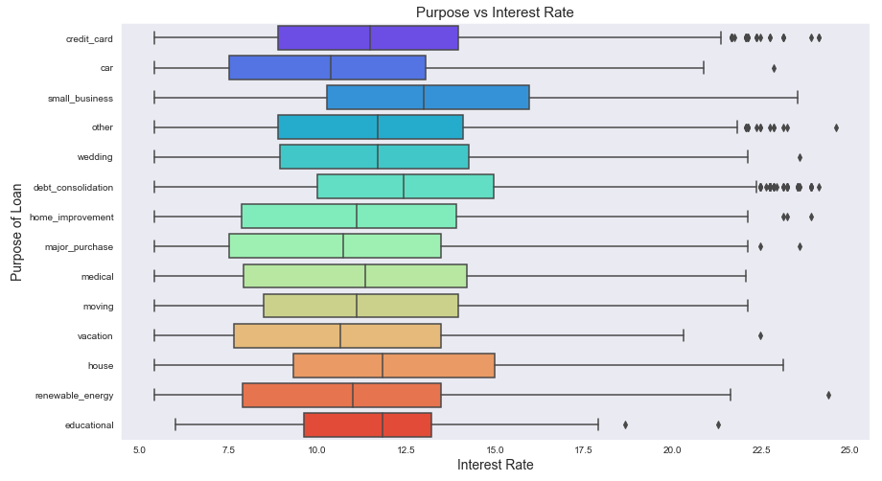
Bivariate Analysis - Purpose vs Interest Rate
Observations:
# It is clear that avearge intrest rate is highest for small business purpose.
# Loans taken for small business purposes had to repay the loan with more intrest rate as compared to other.

Slide 19
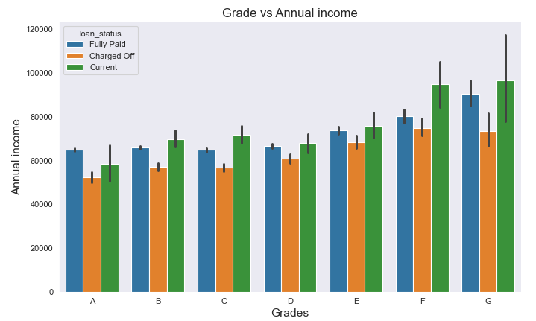
BarPlot to show variation of annual income across grade for every loan status.
Observations:
# From this we can conclude that the ones getting 'charged off' have lower annual incomes than the ones
# who'paid fully' for each and every grade (i.e. at same interest range)

Slide 20
Conclusion
1. lower annual incomes are more likely to be defaulter
2. Higher the interest rate higher charged off ratio
3. Those who are not working or have less than 1 year of work experience have 4. high chances of getting charged off
5. Grade "F" and "G" have very high chances of charged off.
6. small Business applicants have high chances of getting charged off.

Slide 21
Thank You

